Slide 1
Diaspora Engagement in Local Development
Cases of Malesi e Madhe and Tropoja Municipalities
Dr. Erka Caro
University of Tirana, Department of Geography
Notes:
Decentralization and Local Development

Slide 2
Outline
Scope and objectives of the study
Research Questions
Theoretical Framework
Case studies
Types of diaspora participation
Research Outcomes
Lesson Learned
Recommendations

Slide 3
Theoretical Framework
Diaspora Definition: “A social collectivity that exists across state borders and has succeeded over time to: (i) sustain a collective national, cultural or religious identity and ties with homeland, and (ii) ability to address the collective interests of members through a developed internal organizational framework and transnational links” (Adamson and Demetriou, 2007)
Diasporas are considered to have the potential to contribute in home countries development through knowledge transfer: human capital ,trade practices, innovative technological skills and entrepreneurship ideas
Diaspora which are developed in organizations have increasingly become important actors in local and community development in home countries.

Slide 4
Scope and objectives of the study
Understand how the Albanian diaspora participate in and support the local development
Main objectives
Capitalize the experience of diaspora involvement in local processes
Explore and articulate the role of dldp in engaging the Diaspora in the preparation of GLP for the municipality of Tropoja and Malesi e Madhe
Present the lesson learned from the process
Notes:
Decentralisation and local development programme

Slide 5
Research Questions
What triggers the participation and involvement of Diaspora in the local development of their origin country/region?
What can be done at the macro level to stimulate a sustainable participation and engagement of the Diaspora?
What are the main challenges of diaspora participating in local development and how can they effectively be supported?
What are the most appropriate approaches to increasing awareness among Albanian diaspora of the need to act jointly on development issues and activities in homeland?

Slide 6
Methodology
Desk research and Review of Existing Practices
Expert semi structured interviews
Questionnaire addressed diaspora members
Case Study Approach

Slide 7
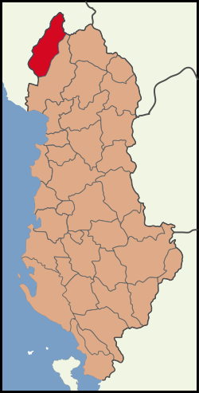
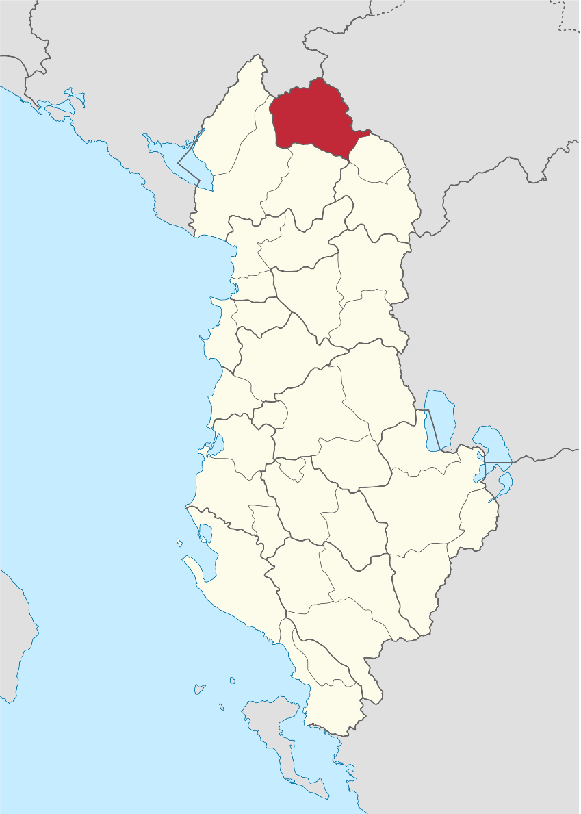
2 Case studies
Malesia e Madhe
Tropoja

Slide 8
Case studies
Involving Diasporas of in the preparation of GLP
The GLP as a good opportunity to attract and tap in ideas and investment - Diaspora was considered a relevant interest group to participate in the preparation of GLP.
Dldp has been working with the diaspora from the Municipalities of Malesia e Madhe and Tropoja in the frame of preparation of the GLP.
Both Municipalities have a very well-established diaspora in the United States of America, due to their long history and chain type of migration
Notes:
involving the diaspora of the municipalities of Malesia e Madhe and Tropojë in the United States to participate and contribute in the process of the preparation and future funding of the General Local Plans in these areas. New York, New Jersey, Connecticut, and Michigan

Slide 9
Communication Steps
Diaspora was provided with information concerning the territorial changes happening in the Municipalities of Malesia e Madhe and Tropoja.
SOME PRECIVED ISSUES
The information received was perceived as not being clear and adequate.
The information was not translated to the Diaspora understandings - As such not assimilated
The information should have been summarized and better transmitted to the diaspora
Understanding the Diaspora
Formal Communication
Phone Calls
Social Media
Notes:
involving the diaspora of the municipalities of Malesia e Madhe and Tropojë in the United States to participate and contribute in the process of the preparation and future funding of the General Local Plans in these areas. New York, New Jersey, Connecticut, and Michigan. New York, New Jersey, Connecticut, and Michigan

Slide 10
Level of Interest
Both first generation and second generation have shown similar patterns of involvements’ levels.
Employed individuals Students and academics have shown low to medium levels of involvement.
The main reasons were perceived corruption and level of poverty, general discontent with the economic situation skepticism about future progress.
Self-employed individuals mainly in the Real Estate and Construction industry have shown moderate to high level of involvement. The main difference within subgroup is how much do they relate to the homeland
Notes:
.e. Individuals that travel there once a year for vacations, have prior investment experience in Albania, or have parents that live in Albania have shown a strong interest in the project by offering development industry scenarios, and more importantly commit financially if investments opportunities are offered.

Slide 11
Diaspora from Malesia e Madhe and Tropoja
Malesia e Madhe
  Much larger
  Better organized
  stronger networks between each other,
  clustered in neighborhoods
  stronger links with their localities in the homeland.
  Strong linking institution - the catholic church
  Bigger organizations: Shoqeria Kulturore Artistike Kelmendi /Malesia e Madhe Association /Fondi Humanitar Rrapsha
Tropoja
  Difficult to localize
  Not well organized in a structured organization
  better integrated within the host society,
  more independent from their own ethnic community
  more involved with national issues in the homeland.
  informal social networking
  don't have their unique homeland organization

Slide 12
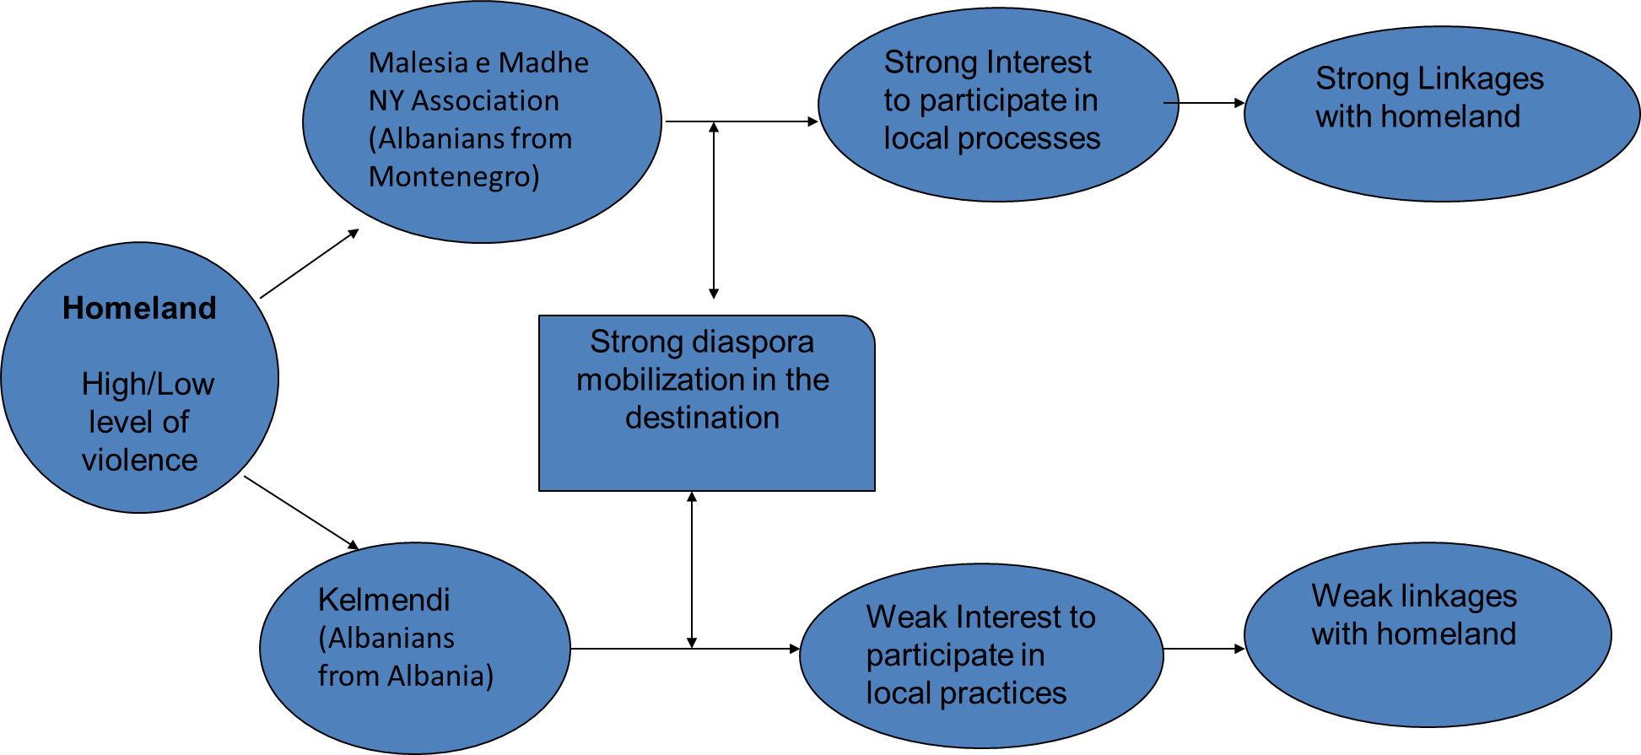
Understanding Diaspora Participation
^{Based on Koinova (2013)}

Slide 13
Research Outcomes
The involvement of Albanian Diaspora with the homeland so far has been at an individual and micro level. The involvement of Diaspora in the preparation of GLP is an important step towards strengthening Diaspora participation at the community and macro level development.
(Spartak Sokoli, Agency for Regional Development 1)

Slide 14
Research Outcomes
Sporadic transnational activities and investments in homeland. There are good signals that the linkages with local communities can be strengthened as there are some success stories – the case of Hoti and Rrapsha where the investments from the Diaspora are taped in successfully.
The initiative of dldp has initiated a shift from exclusion and sporadic passive participation to self-mobilization and an aspiration for functional and interactive participation The diaspora have been exposed and involved in some policy discourses at municipality level and their participation was asked at the decision making level.
Although the challenges of diaspora participation in local processes, there is growing aspiration among diaspora to be more engaged through investments aimed to the development of the region, and also involvement in policy domains concerning their regions of origin which goes beyond remittances and casual visits.
Notes:
The main actor facilitating such participation and engagement is the church which acts as a trusted institution.

Slide 15
Research Outcomes
The Albanian Diaspora in US is very diverse, also between Albania diasporas originating from the same region such as Malesia e Madhe. This calls for the evolvement of representative bodies that connects the Albanian diasporas. Having unified bodies would first serve as a platform for the diaspora to get organised, and secondly would serve as a lobby channel between them and the Albanian Government
Diaspora voiced the challenges to participate in the local processes. There is a perceived lack of interest from local municipalities to create bridges with individuals and diaspora organizations. In response to these perceptions the Albanian diaspora should build lobbying capacity and stronger organizations.
The dual relationships between home and host country needs to be strengthened. The migrants are of the opinion that policies affecting their home countries indirectly affect them in the host country. For instance, hard economic times in their home countries mean that they have to make financial remittances.
Notes:
These differences can be explained with the different motivations of migration, national identities, time of migration, importance of religion and so on.

Slide 16
Lesson Learned
Strengthen the mobilization of diasporas in the country of destination in form of structured organizations.
Channels of communications with diasporas should be diversified and following a top-down approach.
The diasporas, need transparency and flow of information. They also need recognition of their work and investments.
The diaspora need to be heard in different platforms and from different actors. They deem necessary to participate in decision making processes and spread their knowledge and information accumulated in the migration process.
The diaspora should be considered and approached as a participatory actor and excepted to play a role in the decision making processes in the local communities and broader. This is a process that needs time, building trustworthy relations and systematic contacts and networking.
The transnational entrepreneurship and investors needs faster and personalized response from the local representatives (know where and how to find information, avoid time consuming bureaucratic procedures)

Slide 17
Recommendations
Transparency and information flow between policy makers, Diaspora and civil society.
Access to information and platforms on how to contribute in policy making and implementation
Strengthen the statistics on migration and diaspora
Expansion and implementation of national and international platforms for migration and development
Implement the recommendations and lessons learned from research in an effective way.
Include the diaspora in consultations on, and in the realization of, policies and programmes whose outcomes have a meaningful impact on their home countries and local developments
Include the diaspora in the formulation in strategic partnerships and on advisory boards
Support diaspora to (trans)form representative bodies by opening up funding schemes and capacity-building programmes to the diaspora
Engaging diaspora in decision making processes of drafting policies that involve them
Empowering the Diaspora through facilitating and strengthening the transnational business networks .
Notes:
Working together in order to build a functioning network and to secure the flow of information and assistance among different actors
These types of platforms have the potential to grow into important actors in supporting the ultimate goal of synergy between migration and development.

Slide 18
Thank you

